Slide 1
The Fun Way to Learn English

Slide 2
Early childhood is the time for children to learn English.
“The brain’s flexibility and problem solving capacity of a child who speaks two languages will be superior to that of a child who only speaks one language. Linguistic stimulation is an essential factor in brain cell growth.”
Yale Child Study Center
“A child’s brain has a type of innate “language acquisition device” (LAD), which is the human brain’s inherent rules of grammar/syntax. By using this universal grammar/syntax, the child can very easily understand other people’s spoken language, thus mastering this type of language.”
Noam Chomsky, American linguist

Slide 3
Welcome to FasTrack® English
An innovative, fun way to learn English for early learners – age 4 and up
This curriculum, which uses the Interactive White Board, delivers English to your child in a fun, authentic fluent way. Children will hear standard pronunciation throughout this early immersion program.

Slide 4
Methodology
Present = Hear words or phrases
Practice = Repeat
Produce = Activity
Students are full immersed in the English language through songs, stories and interactive games. Throughout the program, the vocabulary aligns with the Cambridge University Starters English Exams.

Slide 5
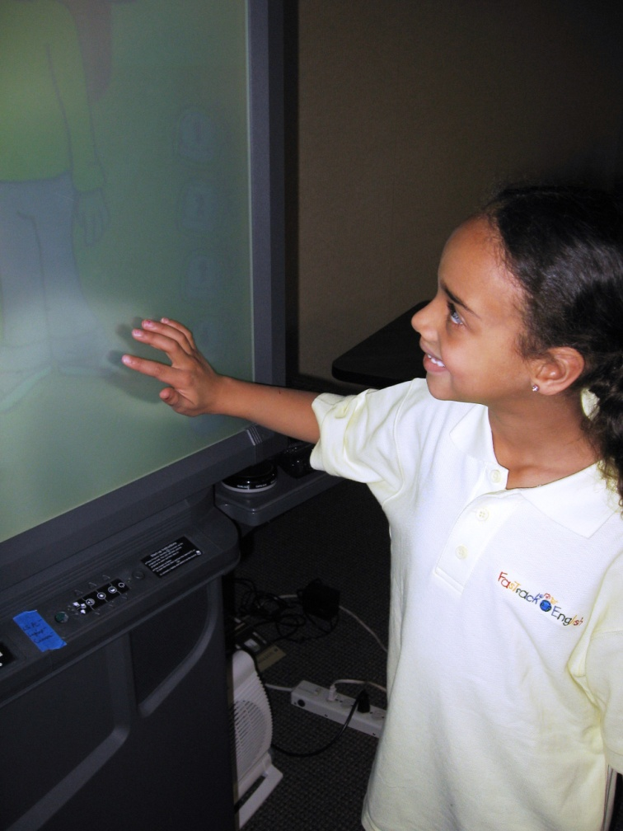
Advantages of FasTrack English
Advantage1 - Interactive learning style to strengthen learning desire
Our children are guaranteed to receive a standardized English content through the interactive Learning Station. The interactive learning style has proven to enhance their learning, desire and concentration during the process of English acquisition.
Advantage 2 - Innovative computer-based curriculum
Our children learn consistent pronunciation from the FasTrack Learning Station - the English expert in every classroom. Bi-lingual teachers focus on each child’s learning progress.

Slide 6
Advantages of FasTrack English
Advantage 3 - Extensive vocabulary to scaffold learning
Our children have the opportunity to discover a vast amount of vocabulary and phrases. As the levels progress, most of the learned vocabulary will be integrated with the new content in order to strengthen the understanding of the language. Students progressively scaffold their ability in English. FasTrack English correlates to standard English examinations.
Advantage 4 - Classroom emphasis is on conversational English
Our children learn vocabulary and phrases used in every day conversational English. Children learn the context for using the words through interactive exercises and games.
Advantage 5 - Stress-free opportunities to practice speaking English
In every class, our children are encouraged to practice speaking English in a safe and fun environment. Children will speak in groups and individually as their confidence builds. Our children learn to ask and respond in complete sentences at all times.

Slide 7
Advantages of FasTrack English
Advantage 6 - Classic English nursery rhymes to reinforce the lessons
Our children learn and sing the same classic English nursery rhymes that their native counterparts sing at the same age. The children easily become immersed in English while singing along with the songs. As the children sing the songs, they actively use the vocabulary they have just learned in the lesson.
Advantage 7 - Learn about major countries of the world to broaden worldview
Our Children are given the opportunity to learn about 37 different countries all over the world. They truly expand their global vision, and understand different kinds of cultures other than their own.
Advantage 8 - Internationally recognized phonics system
Our children are taught to use the world’s most recognized phonics system to build a solid foundation for reading and writing.

Slide 8
Advantages of FasTrack English
Advantage 9 - Interactive games to stimulate learning desire
Our children will learn English through games to help them retain the information they receive for that lesson. The games will keep them focused and maintain a high level of interest. The games also create a stress free environment where the children are free to delve into their English setting, which helps to produce spontaneous English communication.

Slide 9
Learning Schedule
YEAR 1
Learning Focus:
Family Members, Counting, Colors,
Shapes, Body parts, Toys, Places, Animals
Places, Occupation, Fruits, Vegetables,
Drinks
Achievement:
Basic Alphabet
37 Countries
Basic Conversation Skills

Slide 10
Learning Schedule
YEAR 2
Learning Focus:
Clothes, Adjectives, Actions, Musical Instruments,
Sports, Verb Phrases, Weather, Outdoor Activities,
Household Items & Duties
Achievement:
Basic Reading Skills
Basic Reasoning Skills
Basic Writing Skills

Slide 11
Learning Schedule
YEAR 3
Reading, Writing and Analytical Thinking
Learning Focus:
Content Learning, Reading & Writing and
Analytical skills
Achievement:
Build 2,000-3,000 word vocabulary
Comprehensive reading and writing skills
Preparation for Cambridge English Exam

Slide 12
Parent Recommendations
Alan benefits greatly from the FasTrack English curriculum, and his interest in studying English has increased. His vocabulary is very big, and he is often able to use English in his daily life. From time to time he speaks a string of English with perfect pronunciation and intonation. He can sing English songs with ease and fluency, with great emotion.
Alan’s father
I have happily observed that my child’s enthusiasm for studying English increases day after day. On one hand this is because of her interest in learning a new language other than her native language. But on the other hand, it is also a result of the interaction between the teacher and the students in the classroom. The fun method of teaching makes studying very easy for the children, and it has generated great enthusiasm and participation.
- Athena’s mother

Slide 13
Expert Recommendations
Dr. Volker Hegelheimer Ph D., Education Psychology, USA
The FasTrack English program is a highly interactive and engaging program for young learners of English that effectively integrates innovative technology.
Fernanda Verdino, ESL Specialist, USA
I found this to be a beautifully integrated ESL program which takes into account all the disciplines of Second Language Learning: listening, speaking, reading, and writing. The Learning Station is especially suited for teaching a foreign language, in this case Standard American English, since it is interactive and entertaining. Children have an opportunity to learn a Second Language naturally and in an engaging and fun way. This ESL program allows children
to learn American English in a positive, nurturing, and happy environment.

Slide 14
Expert Recommendations
Lygia Stebbing M.A., Education, Concentration Early Childhood Education, USA
This is a very comprehensive and varied curriculum that can appeal to an array of learning styles though diverse delivery methods. The repetition is excellent as the curriculum frequently refers back to prior lessons and repeats lessons in a very thoughtful manner.
Dr. Stella Erbes PhD., Educational Psychology, USA
The FasTrack English program successfully integrates activities that appeal to all learning modalities (visual, auditory, kinesthetic, and tactile). The lessons promote student participation and active learning to ensure that all students leave speaking English and enjoying the process of learning language.

